Slide 1
Team
MPassion
Real time sign language to speech converter

Slide 2
Problem Statement
Enable better communication between people using sign language i.e. people with speaking & hearing disability and those who communicate via speech.
A lot of problems faced by people with auditory impairments are due to inability to communicate with people who don’t use sign language. While it may not be feasible to treat them medically, we think enabling a communication channel would alleviate their problems.

Slide 3
Overview of Problem
Approximately 69 lakh Indians suffer from hearing or speech disabilities. (Source: Census Report of 2011)
There are just about 250 certified ISL(Indian Sign Language) interpreters in the country.
NGOs, ISLRTC deaf communities are working towards increasing number of ISL interpreters and making ISL India’s 23rd official language.

Slide 4
Overview of Problem (contd.)
The Rights of Persons with Disabilities Act prescribes provision of sign language interpreters at public facilities, services, schemes, and programs. There is no implementation till date.
Children deprived from learning sign language and deaf children are forced to attempt speech which is very uncomfortable for them.

Slide 5
Problems faced due to communication barrier:
Reliability on sign language interpreters who are very few in number
Inaccessibility to information in public offices and private firms
Inability to communicate with family: About 90% of deaf population has hearing parents and 88% of the parents don’t know sign language
Depression and anxiety due to social exclusion

Slide 6
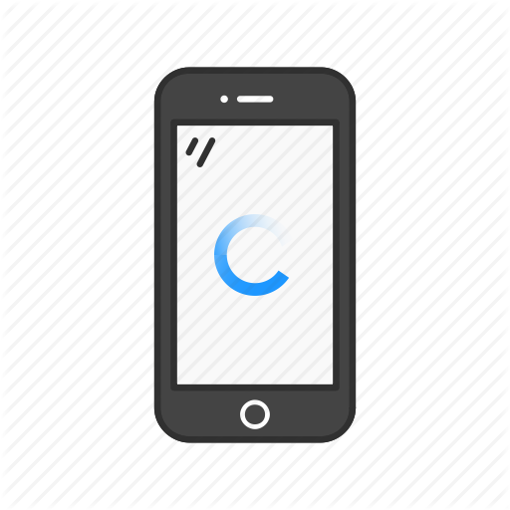
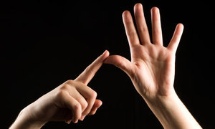

Solution Proposed:
Real time sign language to speech converter app

Slide 7
Impact of Solution:
Problem of lack of sign language interpreters would be solved to a great extent.
Would improve job opportunities for the disabled.
Would help mental health counsellors and doctors to treat ailments of people using sign language better.
Would be used in public offices and private firms to effectively disseminate information and solve queries of people with auditory impairments.
Sign language would be taught to more people with speaking and hearing disability thus enabling social inclusion and relieving them from the pressure to attempt speech.

Slide 8
Future improvements and Additions
Sentence level translation
Integration in phone /video calling to enable long distance communication
Speech to text/sign language integration

Slide 9
Technical Aspect of Proposed Solution
Image frames generated from live input video
Image pre-processed to be fed to neural network
CNN model with image augmentation
Predicted gesture output in form of text converted to audio

Slide 10
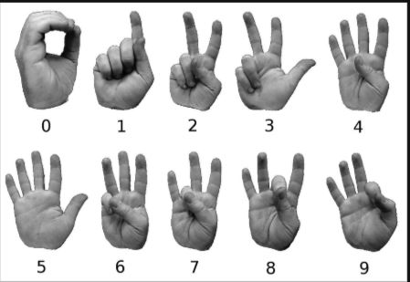
Dataset Used:
ASL BU Corpus dataset used for training. Approximately 1500 images, 55/class.

Slide 11
Image Pre-processing:
Image frames generated from live input video taken by phone camera are pre-processed before feeding into neural network.
Background Subtraction
Locate object (hand) specifically
Padding image to square shape
Resizing image to feed into neural network

Slide 12
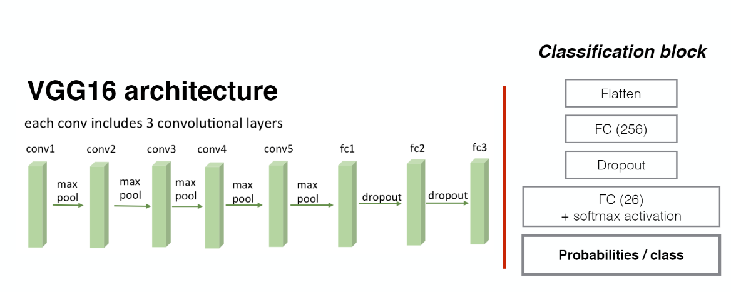
Neural Network Architecture

Slide 13
Neural Network Architecture (contd.)
Used transfer learning model
Convolutional base (frozen layers) of VGG16 network for feature extraction.
Classification block containing fully connected layer and softmax activated layer
Model trained using images from dataset and augmented data from image data generator

Slide 14
Market Analysis
We plan to make the app available on PlayStore and introduce it in:
Government Offices
International and National transport stations
NGOs
400+ schools for specially abled
134 AAI Airports in India
The proposed solution involves development and deployment costs which can be recovered through low price subscription plans or with monetary support from government.

Slide 15
Thank You!
Please reach out to us if you have any queries.
Contact: agr.prachi22@gmail.com
+91 8769782883

